Slide 1
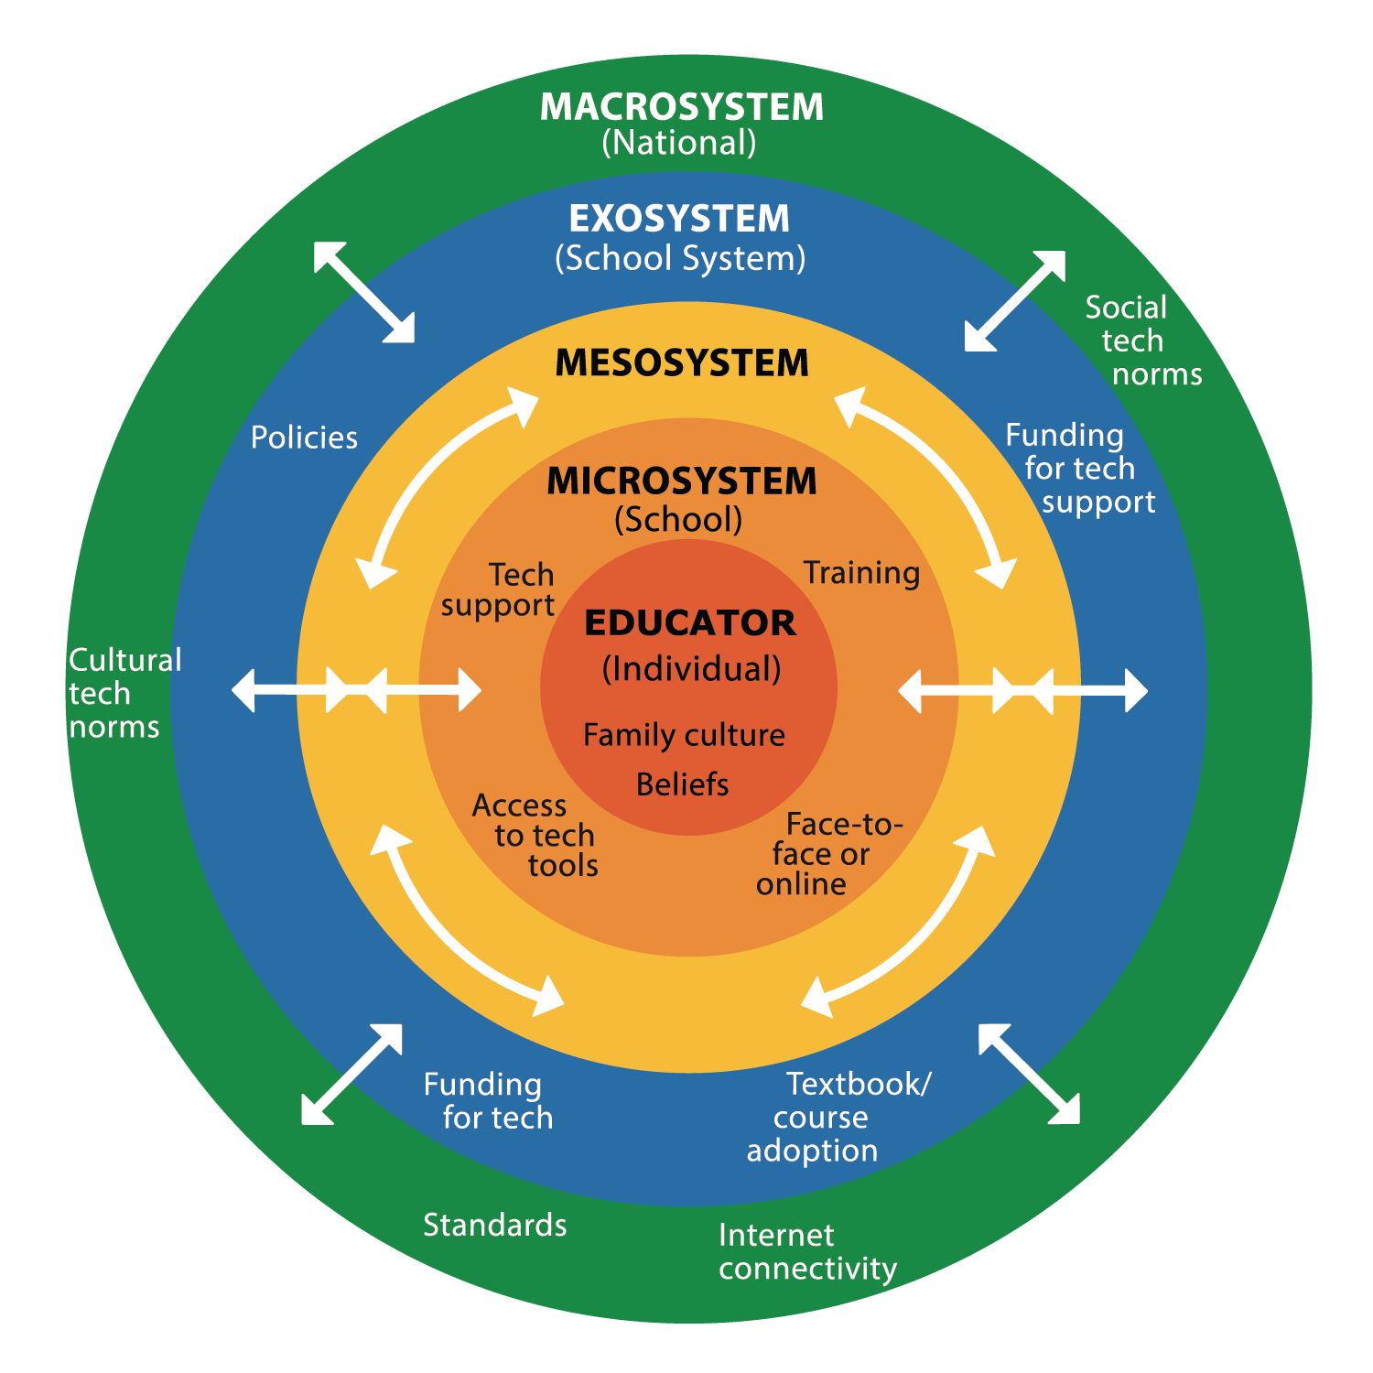


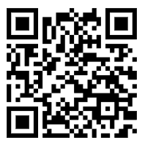
























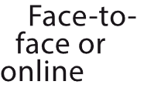





Socio-Ecological Technology Integration (SETI)
Crompton, Burke, Nickel, & Chigona (2024)

